Slide 1

Automation Testing
By- Manas

Slide 2
ACTIONS
We are using actions to perform miscellaneous operations like Mouse Movements, Sendkeys, Double Clicks, Drag And Drop, ClickandHold etc..
For working with Actions, we need to import Actions class by creating object.
Syntax: Actions object=new Actions(WebDriver Driver)

Slide 3
Sending Keyboard Operations using Actions:
We are using Actions also for sending Keyboard operations to the application.
Syntax: Actions object=new Actions(WebDriver Driver)

Slide 4
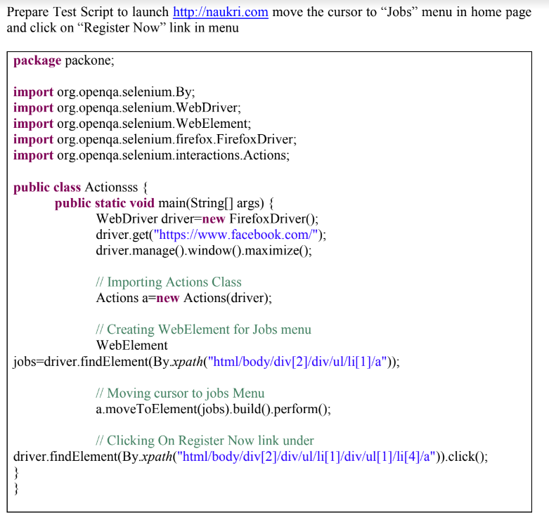

Slide 5
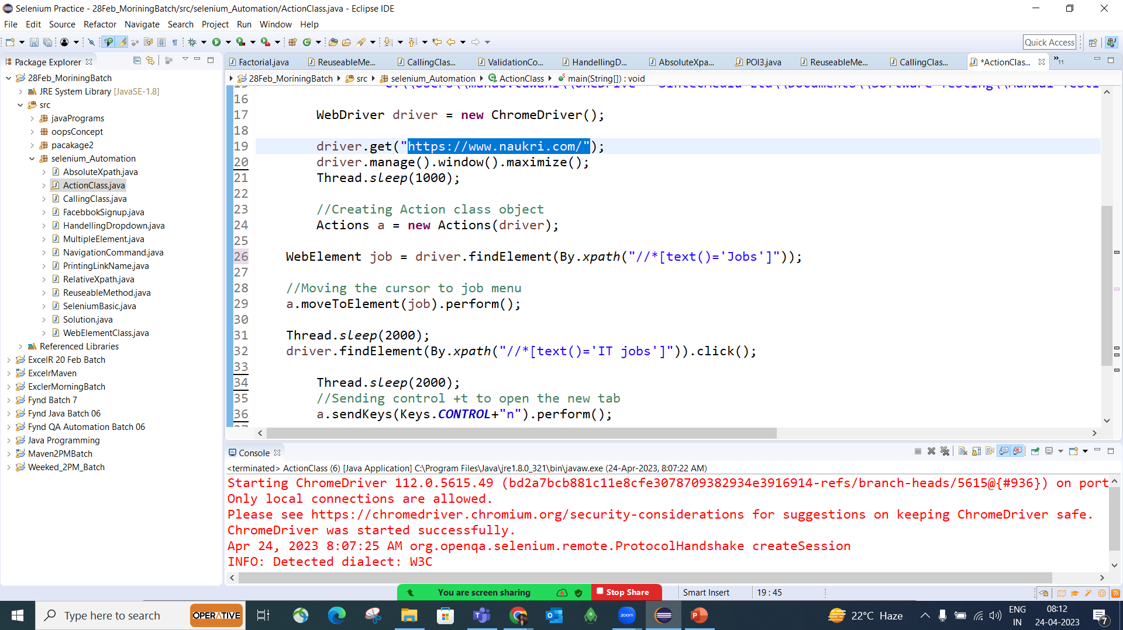

Slide 6
